Slide 1

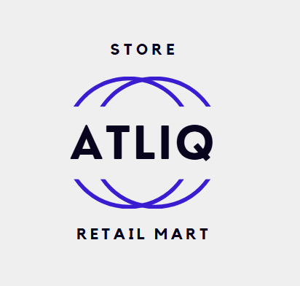
AtliQ Mart Diwali & Sankranti Promotion Analysis
This presentation looks at how well AtliQ Mart's Diwali and Sankranti promotions worked and gives suggestions to improve future marketing plans.
by BONDALAPATI AGASTEEN

Slide 2
Introduction
This presentation reviews how well the Diwali 2023 and Sankranti 2024 promotions worked in AtliQ Mart's 50 stores. The goal is to find what worked well and give useful ideas for future campaigns

Slide 3
Business Context
AtliQ Mart, a retail giant in southern India, ran massive promotions during festive seasons to boost sales. The effectiveness of these campaigns needs analysis to inform future strategies.

Slide 4
Data Description
Data is sourced the following tables:
dim_campaigns: Campaign details (Campaign id, Name, Start date, End date)
dim_products: Product information (Product Code, Name, Category).
dim_stores: Store id and city data.
fact_events: Sales events (Event id, Store id, Campaign id, product Code, Base Price, Promo Type, Quantity Sold(Before/After)).

Slide 5
Recommended Insights
1. Store Performance Analysis
2. Promotion Type Analysis
3. Product and Category Analysis

Slide 6
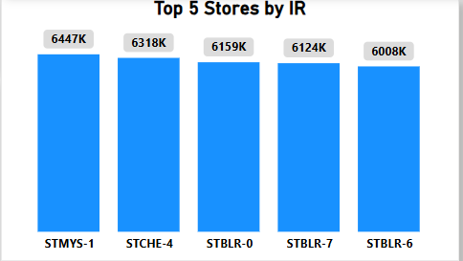
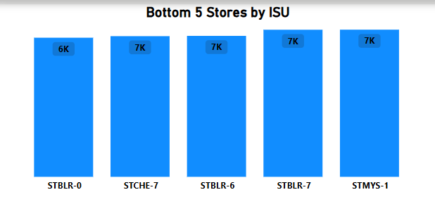
Store Performance Analysis
Top 5 Performing Stores by Incremental Revenue (IR)
Bottom 5 Performing Stores by Incremental Sold Units (ISU)

Slide 7
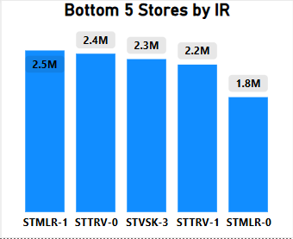
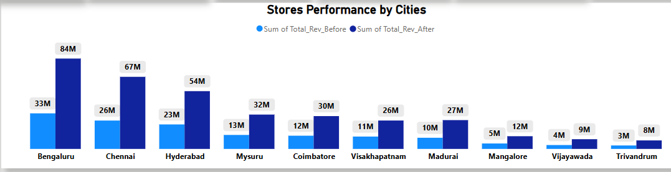
Bottom 5 Performing Stores by Incremental Revenue (IR)
Stores Performance by Cities

Slide 8
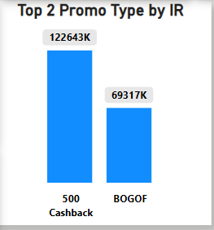
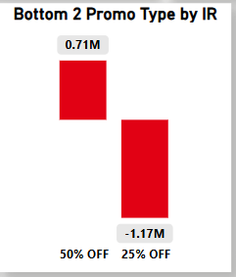
Promotion Type Analysis
Top 2 promotion types with the highest incremental revenue (IR).
Bottom 2 promotion types with the highest incremental revenue (IR).

Slide 9
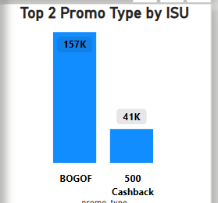
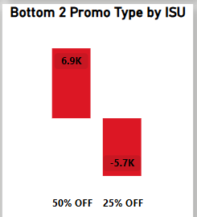
TOP 2 promotion types in terms of their impact on Incremental Sold Units(ISU).
Bottom 2 promotion types in terms of their impact on Incremental Sold Units(ISU).

Slide 10
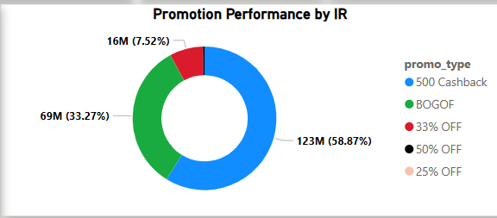
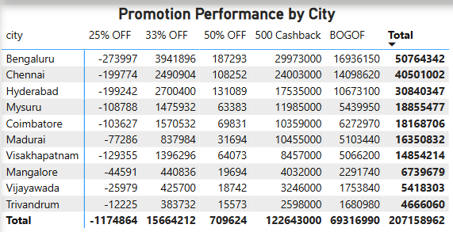
Promotion performance by incremental revenue (IR)
Promotion performance by cities (IR)

Slide 11
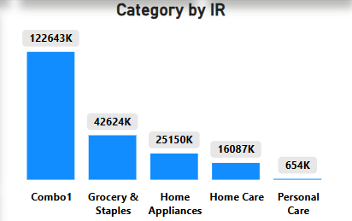
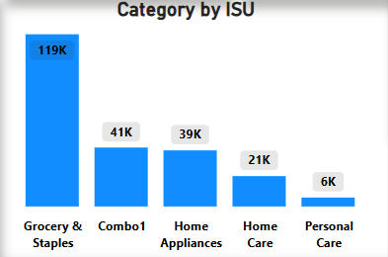
Product and Category Analysis
Category in terms of Incremental revenue(IR).
Category in terms of Incremental Sold Units (ISU).

Slide 12
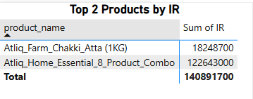
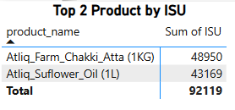
Top 2 Products in terms of Incremental revenue (IR).
Top 2 Products in terms of Incremental Sold Units (ISU).

Slide 13
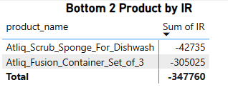
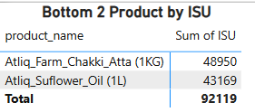
Bottom 2 Products in terms of Incremental revenue (IR).
Bottom 2 Products in terms of Incremental Sold Units (ISU).

Slide 14
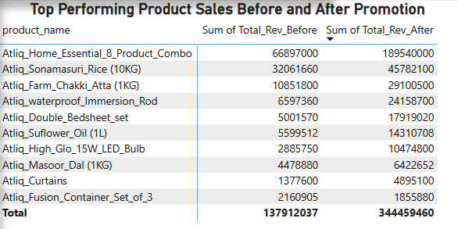
Top 10 Products in terms of Revenue Before and After

Slide 15
Ad-hoc Queries and Reports
• High-value products on BOGOF promotions
and base price > 500.
• Store count by city for operational optimization.
• Campaign-wise revenue before and after promotions.

Slide 16
High-Value Products
High-value products on BOGOF promotions and base price > 500.
Product Name | Base Price | Promotion
Atliq_Double_Bedsheet_set | 1190 | BOGOF
Atliq_waterproof_Immersion_Rod | 1020 | BOGOF

Slide 17
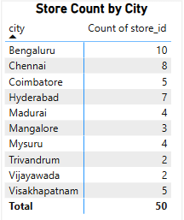
Store Count by City

Slide 18

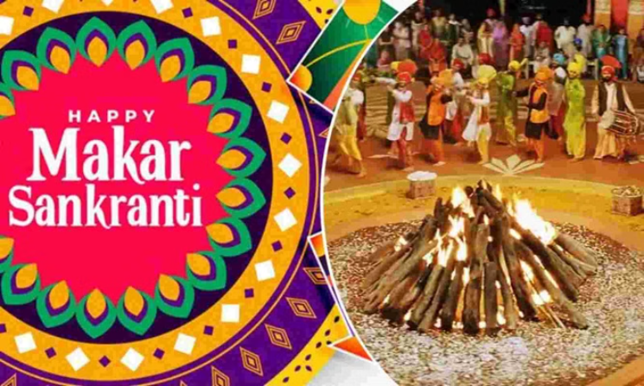
Campaign Revenue
Diwali | $207456209 Sankranti | $140403941

Slide 19
Recommended Insights
Top Stores by Incremental Revenue (IR):
The highest-performing store is STMYS-1 (Mysuru) with an incremental revenue of $6,446,961, followed closely by STCHE-4 (Chennai) and STBLR-0 (Bengaluru).
Stores in Bengaluru dominate the top 5, highlighting their market potential.
Recommendation:
Focus on expanding promotions and marketing in these regions to maximize returns.
Bottom Stores by Incremental Sold Units (ISU):
Stores like STMLR-0 (Mangalore) and STVSK-3 (Visakhapatnam) have the lowest incremental sold units, with less than 2,300 units sold during promotions.
Recommendation:
These stores might need special promotions or strategies to improve, like using different types of promotions together or focusing on local preferences.

Slide 20
Recommended Insights
Promotion Power Play: Uncovering the Top Performers
500 Cashback
This promotion was the clear winner, bringing in an impressive $122,643,000 in extra revenue and selling over 40,000 units. That's a big success!
BOGOF (Buy One Get One Free)
Although it didn’t bring in as much money, this promotion was still a hit, with 157,073 units sold. Customers really enjoyed the extra freebie!
Discounts (25% OFF, 50% OFF)
Unfortunately, the usual discount strategies didn’t work well, having little or even negative impact on revenue. It’s time to rethink these old methods and focus on what really works.
Recommendation:
The best way to succeed with promotions is by using cashback and BOGOF (Buy One Get One Free) offers. Focus on these successful strategies instead of discounts

Slide 21
Conclusion
• Key insights and strategies to improve future campaigns.
• Focus on data-driven decision-making for sales growth.
• Next steps: Implement recommendations and monitor performance.

Slide 22
Thank You
For further details, please contact the Analytics Team.

